Slide 1

Real-Time User Risk Profiling in Financial Applications Using Unsupervised Learning on Streaming Data
An Adaptive Framework for Risk Profiling in streaming Financial Data
Presenter: Mukund Kumar, MTech (2023AA05458, AIML)
Supervisor: Ashish Verma, Member of Technical Staff - 1, PayPal

Slide 2
Traditional Fraud Detection is Reactive, Not Proactive.
Reliance on Static Data: Traditional systems depend on rule-based engines and supervised models that require large, pre-labeled historical data
Slow to Adapt: They struggle to keep pace with new and evolving threats because their training data quickly becomes outdated.
Lack of Personalization: They often fail to understand an individual user’s normal behavior, leading to a poor customer experience from false positives and a failure to detect novel attacks.

Slide 3
Shifting from Fraud Detection to Real-Time Risk Profiling
My Approach: I have designed, implemented and validated an end-to-end system that:
Learns Individually: It learns each user’s unique behavior using an unsupervised autoencoder, without needing pre-labeled data.
Adapts in Real-Time: The system intelligently adapts to legitimate changes in a user’s behavior using the ADWIN algorithm to handle concept drift.
Provides Dynamic Risk Scores: It calculates a personalized, stateful Z-score for every transaction, offering a nuanced measure of risk.
Ensure Transparency: It generates clear, feature-based explanations for its risk assessments using SHAP to build trust and meet regulatory requirements.

Slide 4
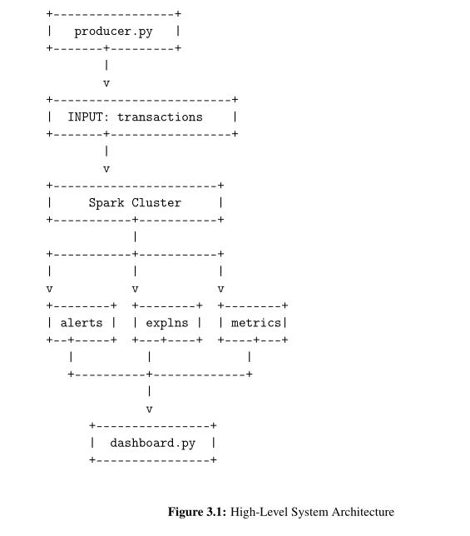
A Scalable, Low-Latency Streaming Architecture
Kafka: The central messaging backbone that ingests high-throughput transaction data.
Spark Structured Streaming: The powerful engine for stateful, real-time data processing and model application
PyTorch & SHAP: The “brains” for the system, performing the unsupervised anomaly detection and generating explanations.
Streamlit Dashboard: The real-time monitoring interface for visualizing performance, alerts, and explanations.

Slide 5
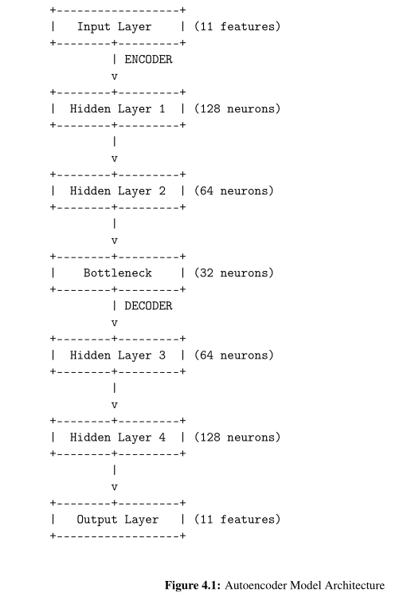
From Raw Data to a Personalized Risk Score
An incoming transaction is processed by the PyTorch Autoencoder, which calculates the reconstruction_error. A high error signals an unusual deviation from the user’s normal pattern..
The error is then normalized into a personalized, Stateful Z-score, which compares the current transaction’s anomaly level to the user’s recent history.
If the Z-score exceed teh defined ALERT_THRESHOLD of 2.5, an alert is generated and sent to the monitoring dashboard.

Slide 6
Staying Relevant: How the System Adapts to Change
The Challenge: A user’s legitimate behavior can change over time. A static model would incorrectly flag these new, normal patterns as high-risk.
The Solution: ADWIN (ADaptive WINdowing)
The system continuously monitors each user’s stream of reconstruction errors.
When ADWIN detects a statistically significant change, it flags a drift event.
This automatically resets the user’s historical profile, allowing the model to re-learn the “new normal” and preventing model decay.

Slide 7
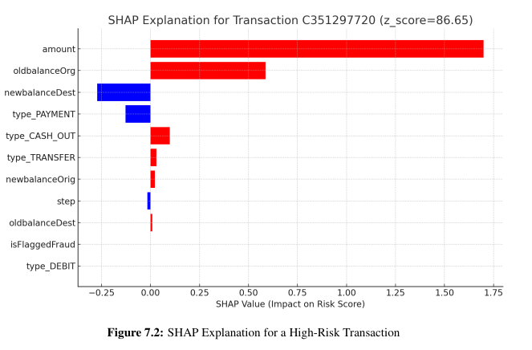
Answering "Why?" with SHAP-based Explanations
Why it matters:
Regulatory Compliance: Fulfills the “right to explanation” required by regulations like GDPR.
Operational Trust: Empowers human analysts to quickly understand and verify automated decisions.
How it Works (SHAP):
For every high-risk alert, the system calculates the exact contribution of each transaction feature (like amount or oldbalanceOrg) to the final risk score.
This provides a clear, intuitive justification for why a specific transaction was flagged.

Slide 8
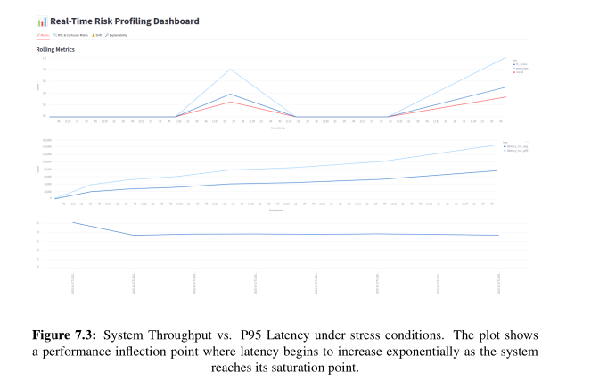
Stress-Tested and Validated for Real-World Throughput
The Experiment: I removed all artificial delays from the data producer to simulate a high-volume transaction flood and identify the system’s operational limits
The Outcome:
The system maintained a stable P95 latency under 200ms while processing up to approximately 1,200 transactions per second.
This result confirms the architecture is robust and scalable for real-time financial monitoring applications.

Slide 9
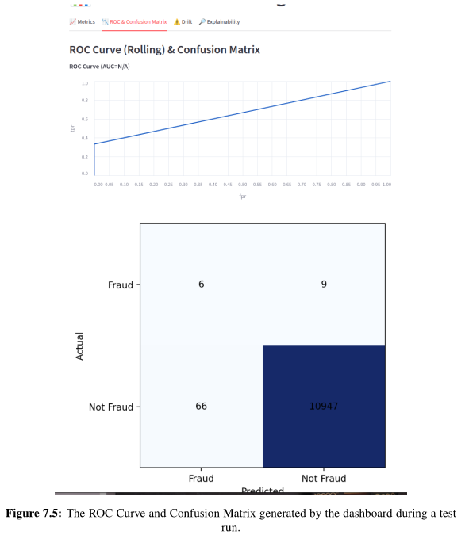
The System in Action: High Accuracy and Clear Insights
High-Risk Detection (True Positive): The system correctly assigned a high Z-score of 86.65 to a known fraudulent transaction, with SHAP identifying amount and oldbalanceOrg as the key drivers.
Normal Behavior (True Negative): It assigns a negligible Z-score of 0.42 to a routine payment, confirming its ability to ignore normal activity.
Overall Performance: The confusion matrix shows a very low false positive rate, with the model correctly identifying over 10,947 legitimate transactions.

Slide 10
Live Demonstration

Slide 11
Conclusion & Future Work
Summary of Achievements:
Successfully delivered a complete, end-to-end MVP for real-time, unsupervised risk profiling, meeting all 6 initial project objectives.
The final system is Scalable, Unsupervised, Adaptive, and Explainable, addressing the core limitations of traditional systems.
Future Enhancements:
Advanced Drift Handling: Implement an online learning strategy to automatically fine-tune the autoencoder model after a drift event is detected.
Ensemble Modeling: Improve accuracy further by integrating an ensemble of different unsupervised models (e.g. Isolation Forests, One-Class SVMs)

Slide 12
Q & A

Slide 13


BITS PILANI
BITS Pilani

